Slide 1
Basic EE
Theory
Practice
Charge
Current
Voltage
Resistance
Power supply
Breadboards
Resistor code
Multimeters

Slide 2
Theory: Charge
A property of particles that experience electromagnetic force
Two kinds of charge: positive and negative
Force due to charge obeys an inverse square law
Charge is measured in coulombs
Electrons and protons each have the same size charge
(but of opposite polarity)
Charge magnitude = 1.6 * 10⁻¹⁹ coulombs

Slide 3
Theory: Current
Current is charge in motion
Most of the time we think about electrons moving
through metallic wires
The flow rate of charge is measured in couloumbs/second
or Amperes (Amps)
charge/time = couloumbs/sec = Amperes
1 Amp = 1.6 * 10¹⁹ electrons / sec

Slide 4
Theory: Voltage
Voltage is the driving force behind current
Voltage is the electrical potential energy a charge has due to
its position in space
potential energy per unit of charge
"path independent“
Voltage is measured in Joules/Coulomb or Volts (V)
Voltage is defined such that negatively charged particles are
pulled towards higher voltages
Potential energy can be converted into other forms of energy

Slide 5
Theory: Resistance
Resistance is a property of materials
Resistors are electrical components with known resistance
Resistor code
Resistors convert voltage to heat
Ohm's law describes the relationship between voltage and
current flow through a resistor
V = I R
V is the voltage across the resistor
I is the current flowing through the resistor
R is the resistance (depends upon the material)
Resistance is measured in Ohms, Ω

Slide 6
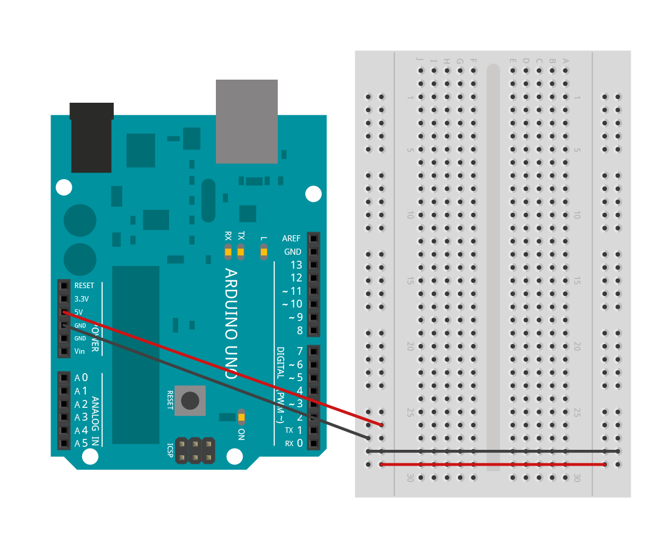
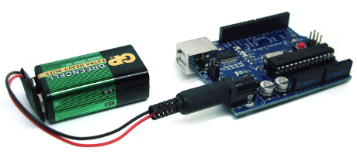
Practice: Power Source

Slide 7
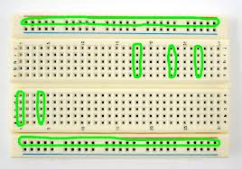
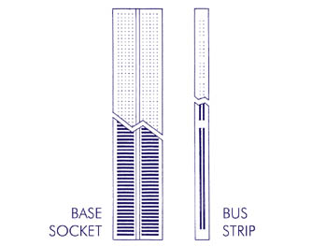
Practice: Breadboard

Slide 8
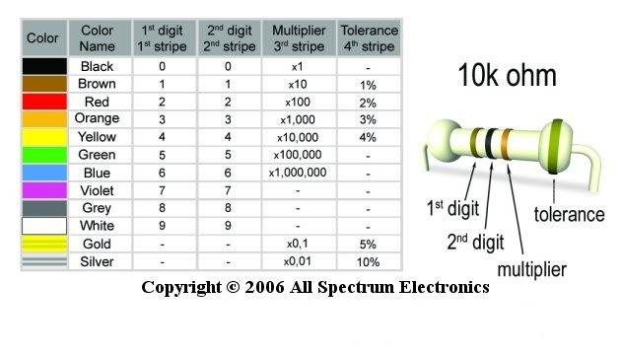
Practice: Resistor Code

Slide 9
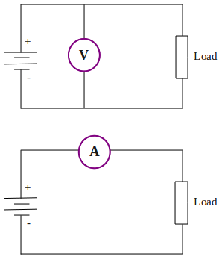
Practice: Multimeters
Voltage:
An across measurement:
Current:
A through measurement:
More detail on using multimeters

